Slide 1

NetDesign
Evan Perez, Usman Abbas, Jair Ruiz

Slide 2

Github Links & Repository Looks
Repository Link: https://github.com/JNikolo/CCNY-Senior-Design
Jair Ruiz - https://github.com/JNikolo
Usman Abbas - https://github.com/uscod
Evan Perez https://github.com/evanperez444

Slide 3
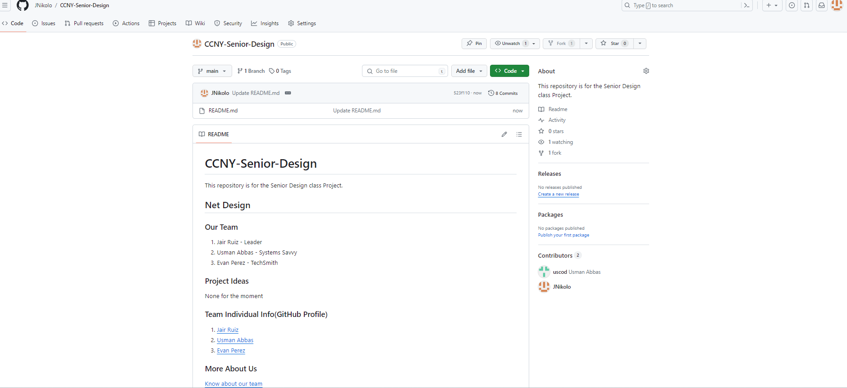
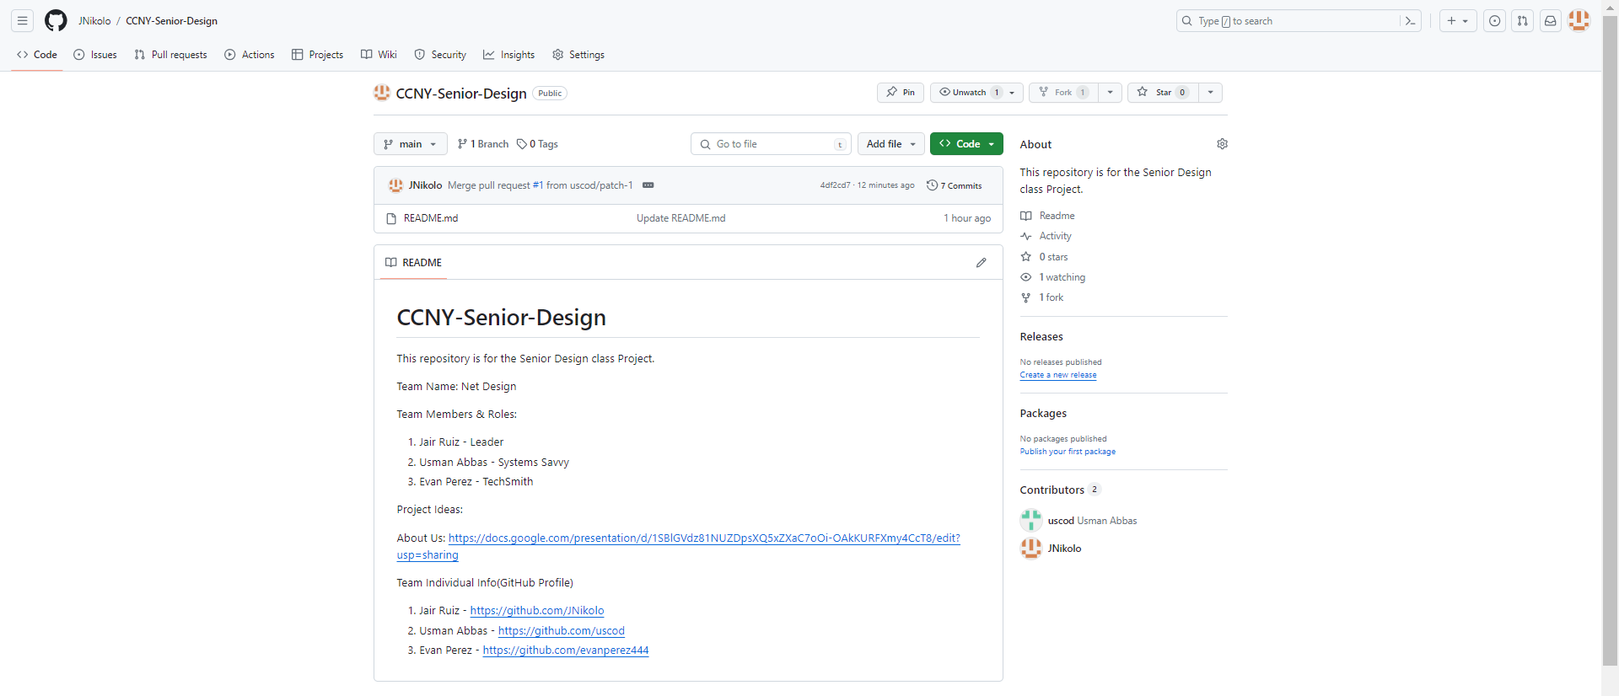

Slide 4

Team Roles
Usman Abbas -> Systems Savvy
Evan Perez -> Techsmith
Jair Ruiz -> Leader
Team Strength -> Collaboration

Slide 5
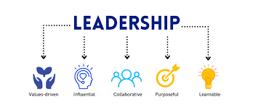
Leader - Jair Ruiz
Task:
Manage and lead completion
Presentations

Slide 6
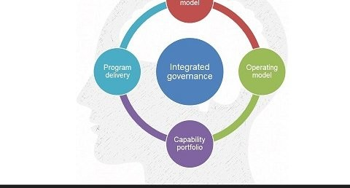
Systems Savvy - Usman Abbas
About Me:
Senior
Experience - Written Reports
Task:
Project Report
Group Documentation
Project Description

Slide 7

Techsmith - Evan Perez
Task:
Leads development
Be up-to date with technology
Most knowledgeable in tech

Slide 8


